Slide 1
Spatio Temporal Kriging for Irregularly Spaced Oceanographic Data : Development and Challenges
2024. 7. 8. / Use R! 2024
Korea Institute of Ocean Science & Technology(KIOST)
Marine Bigdata & A.I. Center
Gi-Seop Lee (Ph.D)
With Jung-Ho Lee, Hong-Yeon Cho & Tae-Kyun Kim

Slide 2
Contents
About Biogeochemical Oceanography
Irregularly Spaced & Gridded Data
Challenges & Solutions
Ongoing & Future Works

Slide 3
I
CHAPTER
About Biogeochemical Oceanography

Slide 4
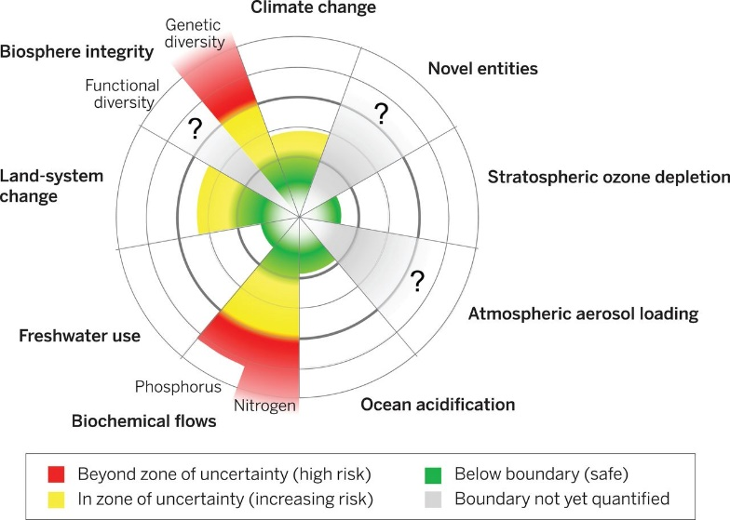
Nutrients in Ocean
Why Nutrients (N, P) are important?
Essential Elements for Organisms
Impact of Anthropogenic Supply
Planetary Boundary Perspective
Primary Producers' Adaptation
Steffen et al., 2015
Martiny, A. C., Vrugt, J. A., & Lomas, M. W. (2014). Concentrations and ratios of particulate organic carbon, nitrogen, and phosphorus in the global ocean. Scientific data, 1(1), 1-7.
Steffen, W., Richardson, K., Rockström, J., Cornell, S. E., Fetzer, I., Bennett, E. M., ... & Sörlin, S. (2015). Planetary boundaries: Guiding human development on a changing planet. Science, 347(6223), 1259855.
Irwin, A. J., Finkel, Z. V., Müller-Karger, F. E., & Ghinaglia, L. T. (2015). Phytoplankton adapt to changing ocean environments. Proceedings of the National Academy of Sciences, 112(18), 5762-5766.

Slide 5
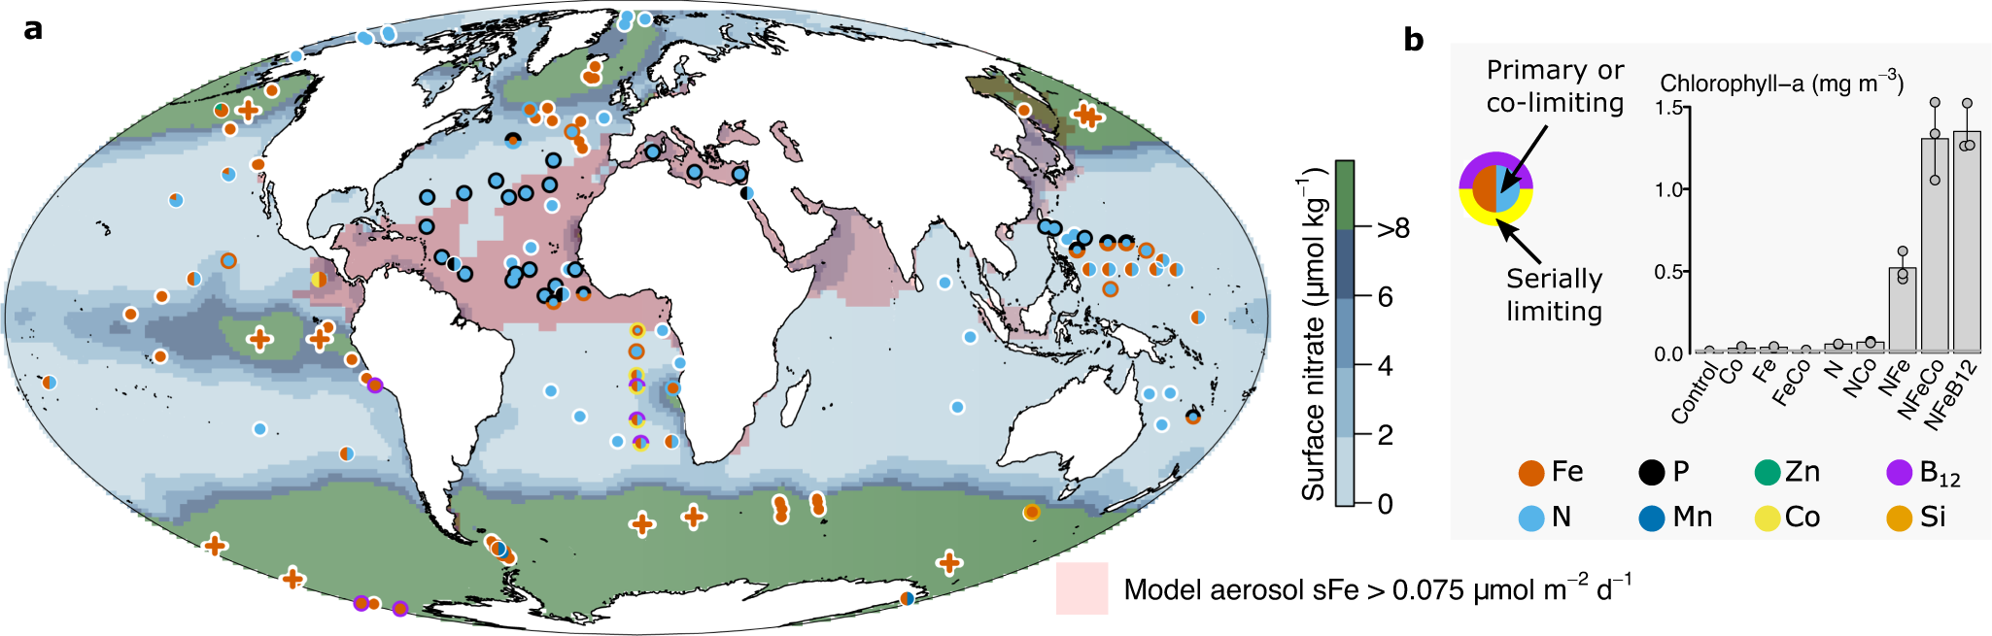
Nutrients in Ocean
Why Nutrients (N, P) are important?
The nutrient limitation → primary producers, global biogeochemical cycles(CO2 exchange),
→ Carbon absorption in the ocean is important from a climate change perspective
Browning, T.J., Moore, C.M. Global analysis of ocean phytoplankton nutrient limitation reveals high prevalence of co-limitation. Nat Commun 14, 5014 (2023). https://doi.org/10.1038/s41467-023-40774-0

Slide 6
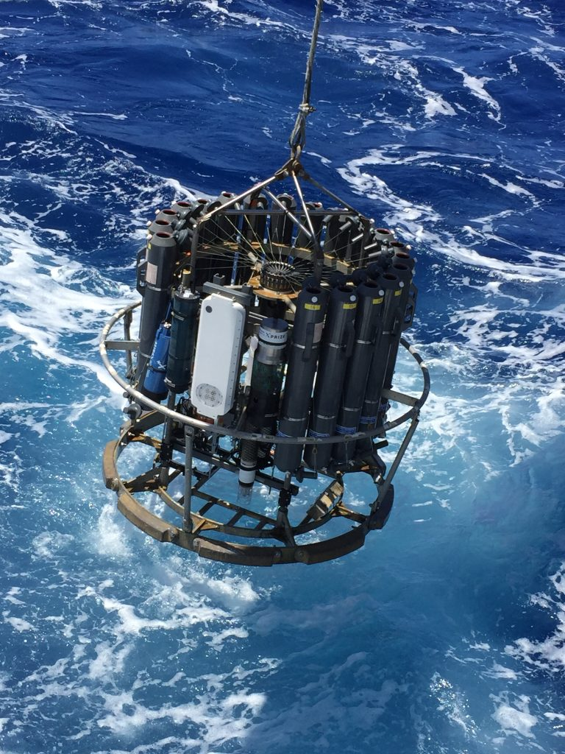
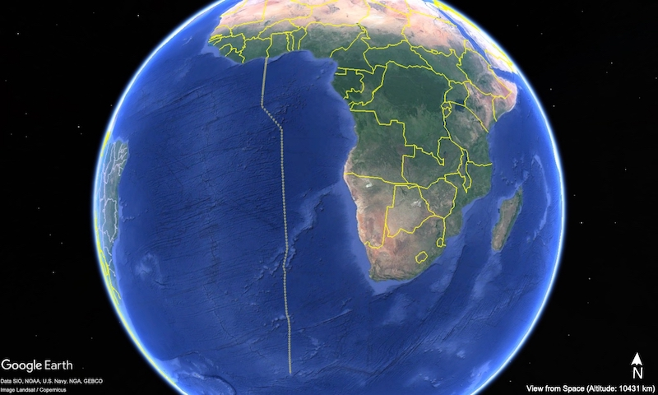
Nutrients in Ocean
In-situ Observation
↑ Water bottles
↑ Each point including downward casting(from surface to bottom)
NOAA’s Atlantic Oceanographic and Meteorological Laboratory (AOML), https://www.aoml.noaa.gov/3-research-cruises-depart-to-improve-understanding-of-atlantic-and-southern-ocean/

Slide 7
II
CHAPTER
Irregularly Spaced & Gridded Data

Slide 8
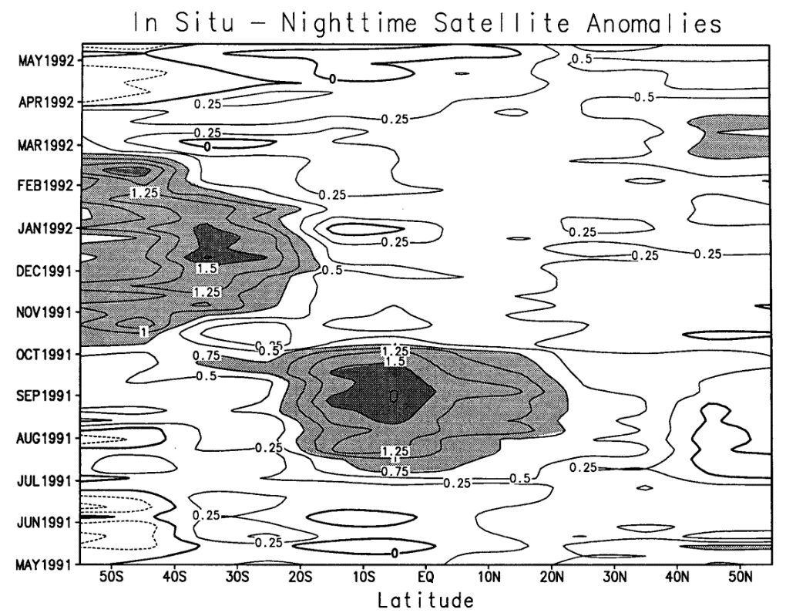
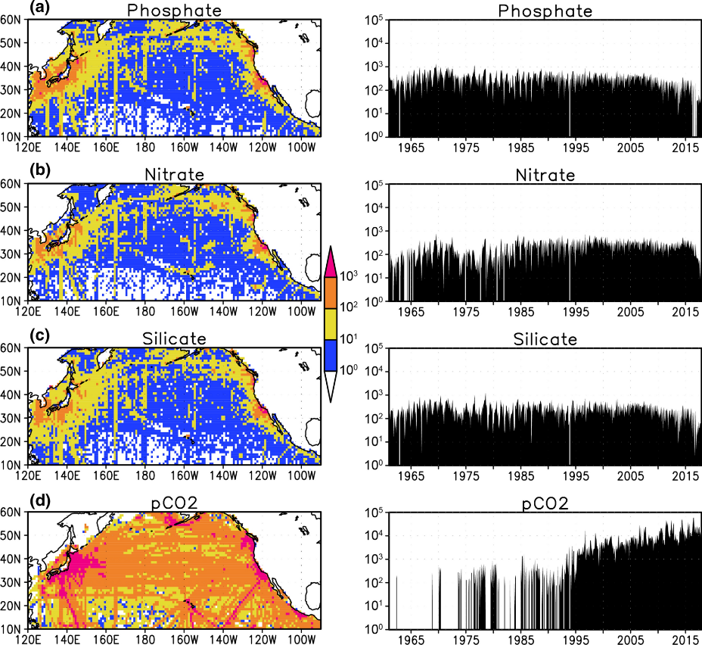
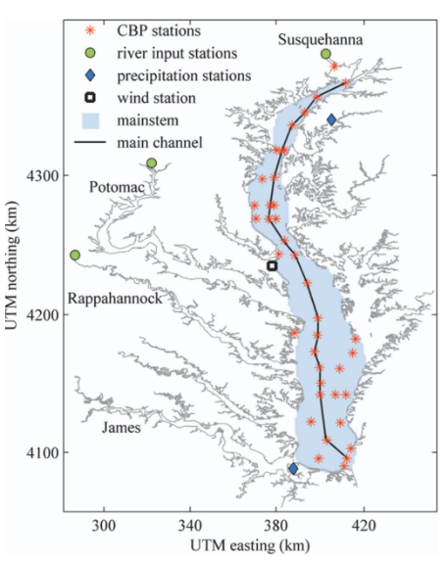
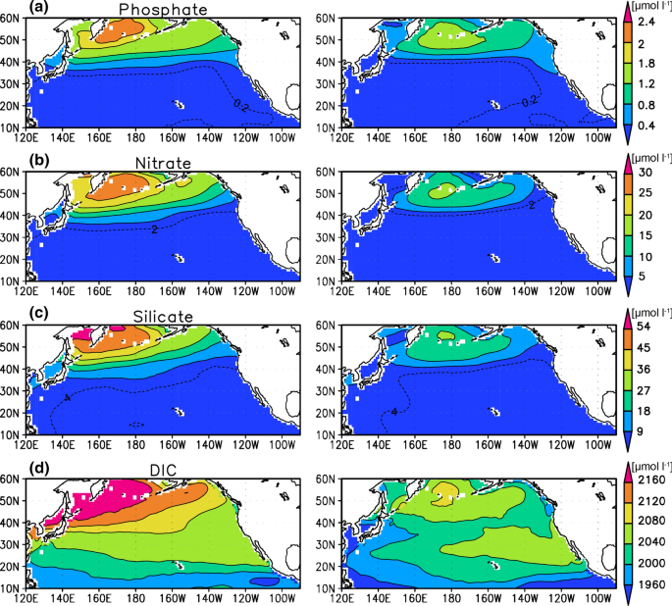
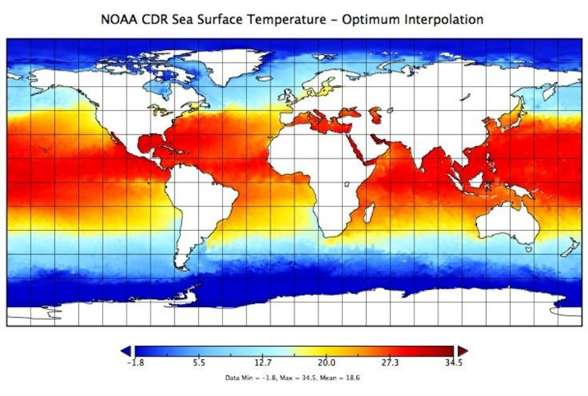
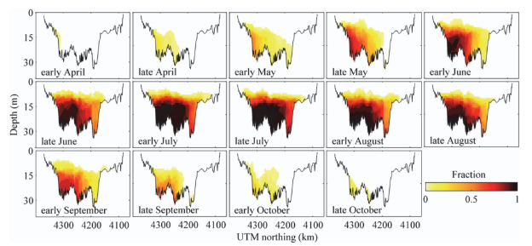
Benchmark Dataset(Gridded)
Gridded Study of Ocean Observation Data Including Nutrients (N, P)
Yasunaka et al. (2014, 2016, 2021); for nutrients
Zhou et al., (2014); for Dissolved Oxygen
NOAA NCEI OISST(Optimal Interpolation Sea Surface Temperature); for Temperature
Zhou, Y., Scavia, D., & Michalak, A. M. (2014). Nutrient loading and meteorological conditions explain interannual variability of hypoxia in Chesapeake Bay. Limnology and Oceanography, 59(2), 373-384.

Slide 9
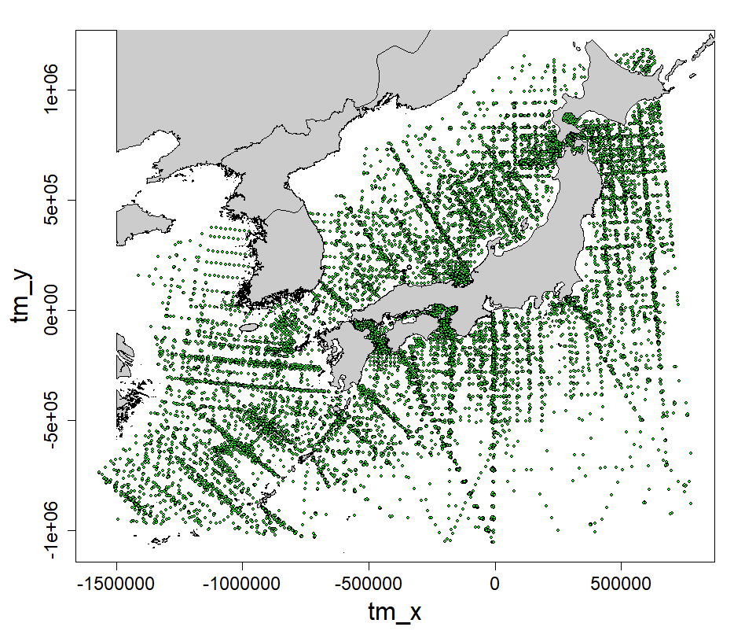
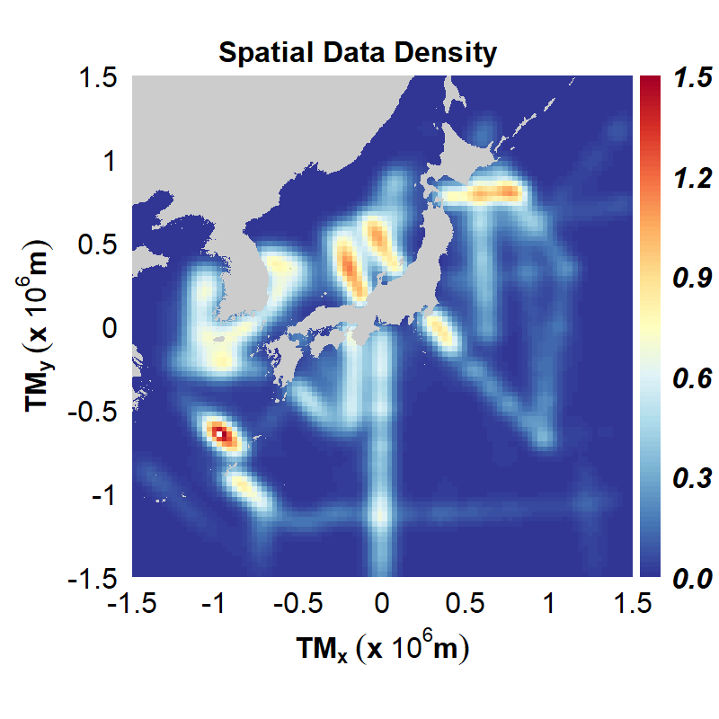
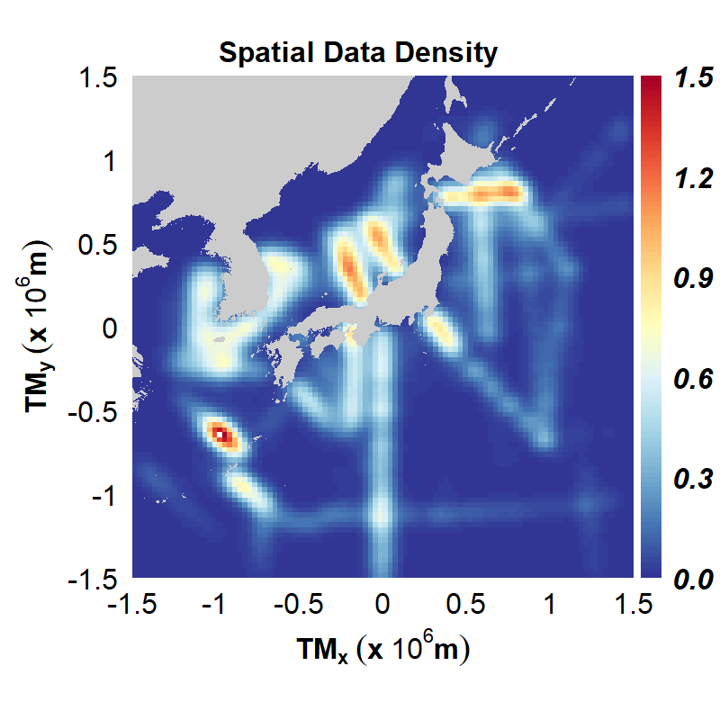
Spatio-Temporal Distribution of Nutrient Data
Spatial Distribution of Nutrient (N, P) Data: Horizontal Direction
Overall Data Density: The entire dataset appears to be spatially dense.
Importance of Exploration Areas: The importance of exploration areas varies spatially.
Sparse Data in Specific Areas: Consequently, data density is very sparse in certain regions.
Points
Density Heatmap
NO3
PO4

Slide 10
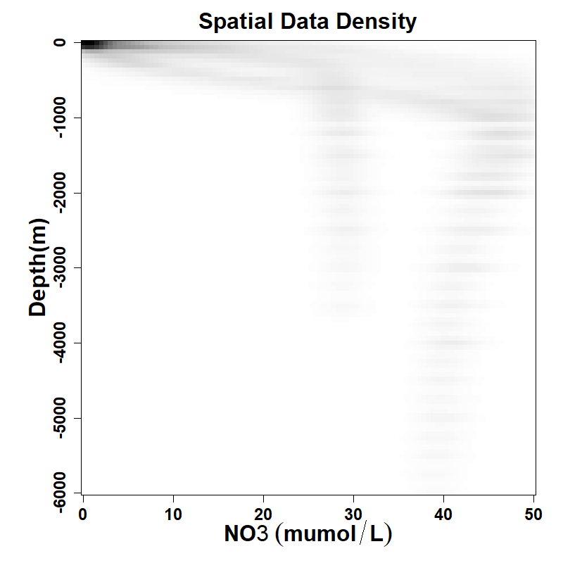
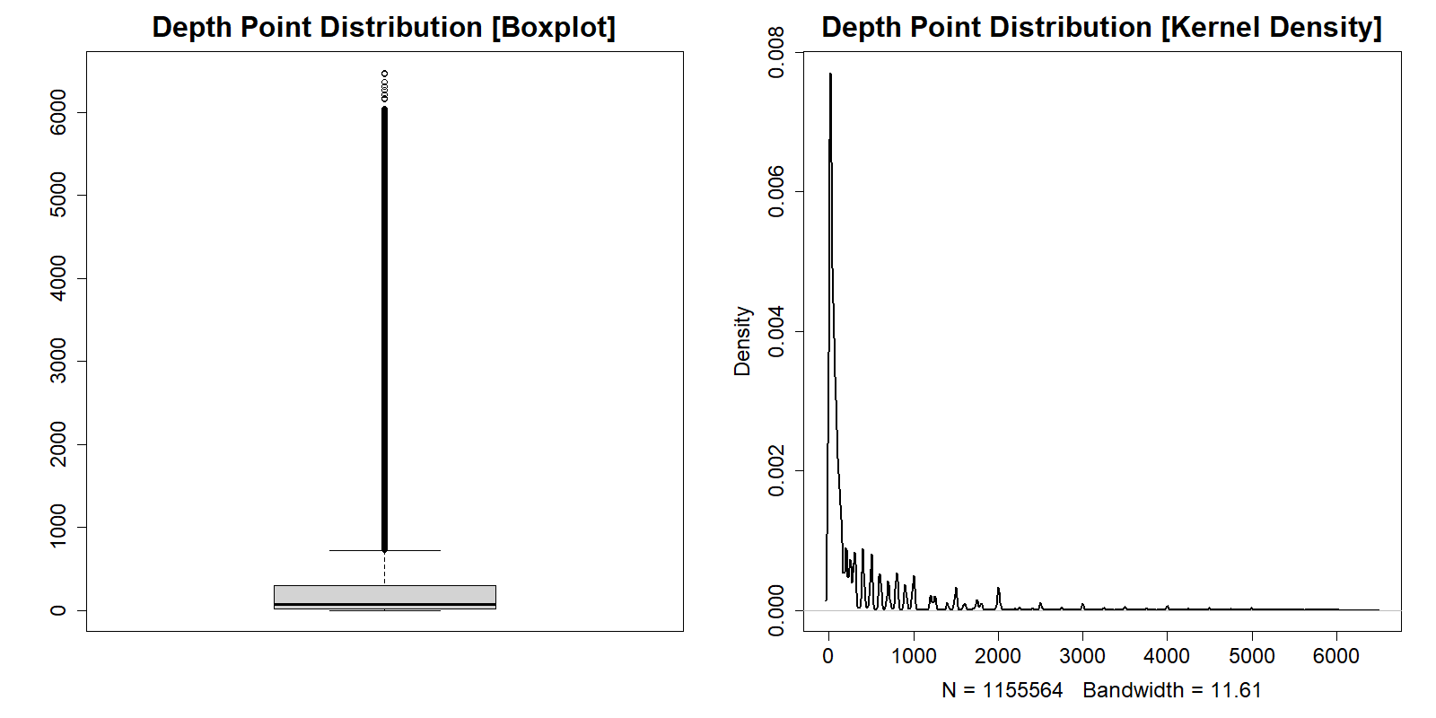
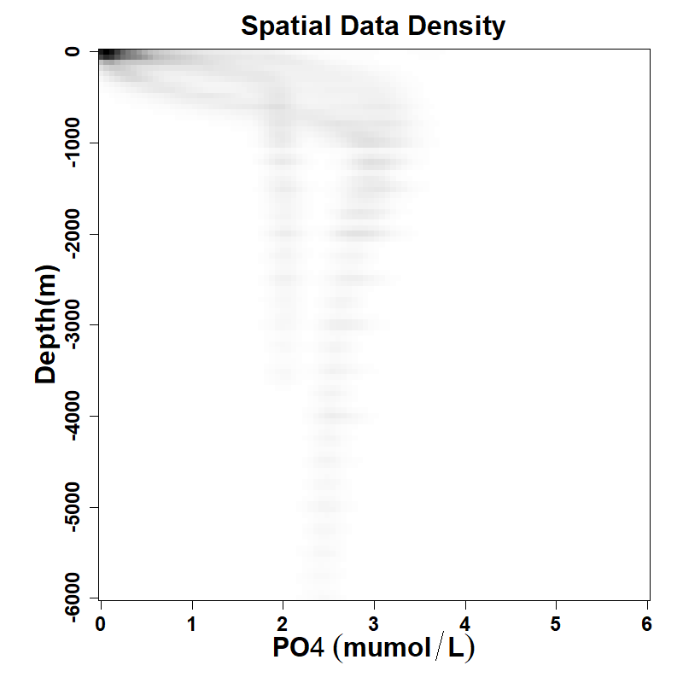
Spatio-Temporal Distribution of Nutrient Data
Spatial Distribution of Nutrient (N, P) Data: Vertical Direction
Variation with Depth
Scarcity of Deep-Water Data
Consistency in Deep Sea
NO3
PO4

Slide 11
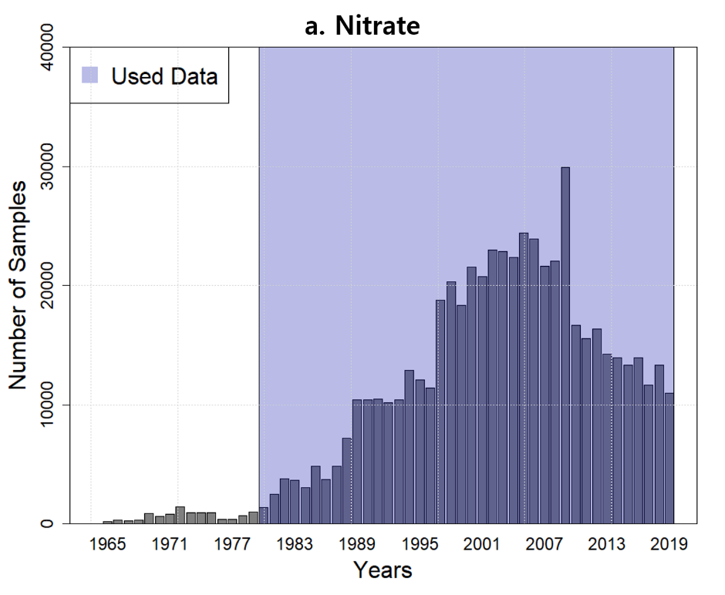
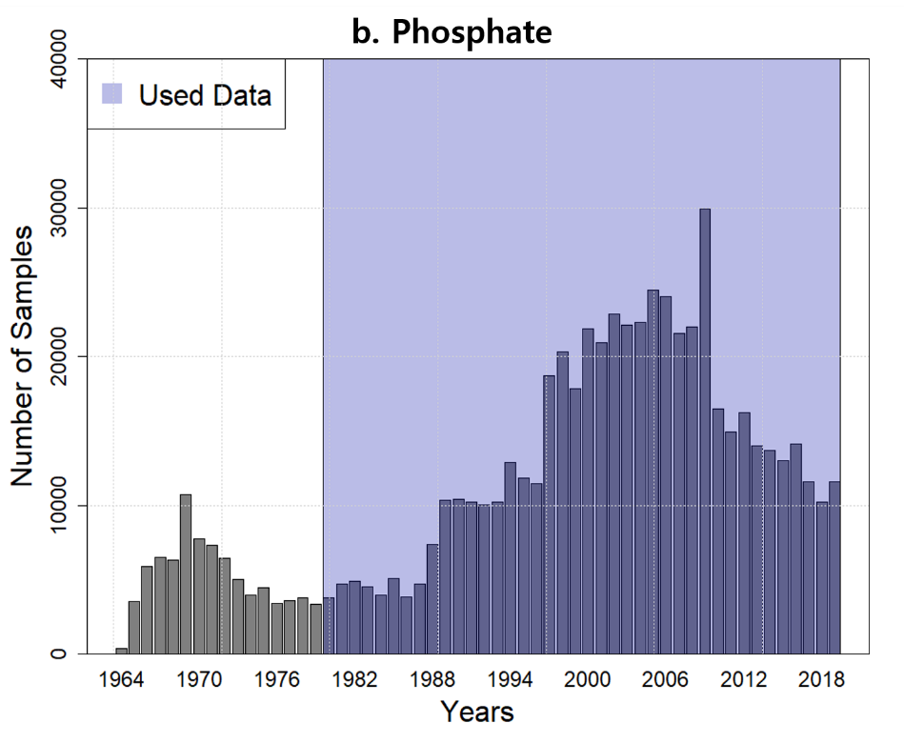
Spatio-Temporal Distribution of Nutrient Data
Temporal Distribution of Nutrient (N, P) Data
Variation in Number of Observation Points Over Time: The number of observation points has changed over time.
Scarcity of Historical Data: Data available from before approximately the year 2000 is sparse.

Slide 12
III
CHAPTER
Challenges & Solutions

Slide 13

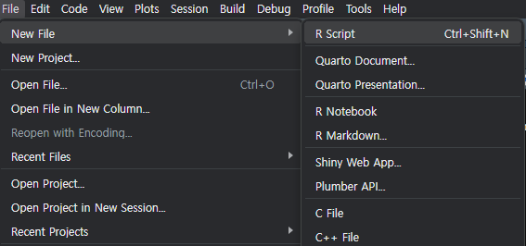
Select Tools
■ That was my Plan A
Using R … O.K.
Using aesthetic libraries including ‘gstat’ … … Over Three-dimensional data types are not supported
It's an extremely harsh ordeal for an oceanographer
So, I opened a new script
<Generated by ChatGPT 4o>

Slide 14
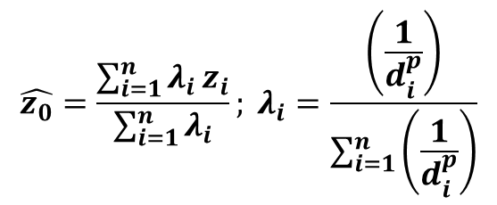
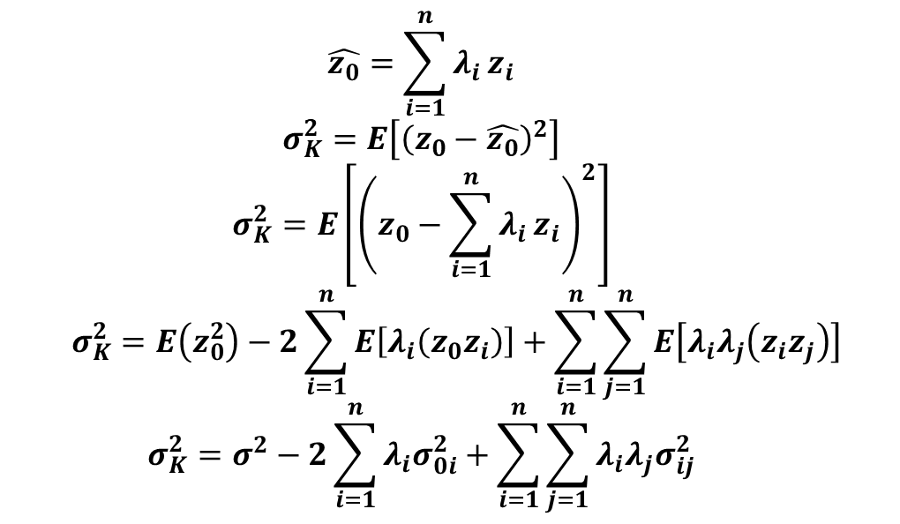
Understanding Spatial Estimation
■ Spatial Estimation Concept
In IDW(Inverse Distance Weighted) Interpolation,
Deriving the Linear Combination via the Gauss-Markov Theorem
Minimization problem to find 𝜆​
$$\hat{z_{0}}=\frac{\sum_{i=1}^{n}{λ_{i}}z_{i}}{\sum_{i=1}^{n}{λ_{i}}}; λ_{i}=\frac{\left(\frac{1}{d_{i}^{p}}\right)}{\sum_{i=1}^{n}{\left(\frac{1}{d_{i}^{p}}\right)}}$$
$$\hat{z_{0}}=\sum_{i=1}^{n}{λ_{i}}z_{i}$$
$$σ_{K}^{2}=E\left[{\left(z_{0}−\hat{z_{0}}\right)}^{2}\right]$$
$$σ_{K}^{2}=E\left[{\left(z_{0}−\sum_{i=1}^{n}{λ_{i}}z_{i}\right)}^{2}\right]$$
$$σ_{K}^{2}=E\left(z_{0}^{2}\right)−2\sum_{i=1}^{n}{E\left[λ_{i}\left(z_{0}z_{i}\right)\right]}+\sum_{i=1}^{n}{\sum_{j=1}^{n}{E\left[λ_{i}λ_{j}\left(z_{i}z_{j}\right)\right]}}$$
$$σ_{K}^{2}=σ^{2}−2\sum_{i=1}^{n}{λ_{i}σ_{0i}^{2}}+\sum_{i=1}^{n}{\sum_{j=1}^{n}{λ_{i}λ_{j}σ_{ij}^{2}}}$$
Bull’s eye effect,
No temporal correlation
! Given these issues, let's apply kriging

Slide 15
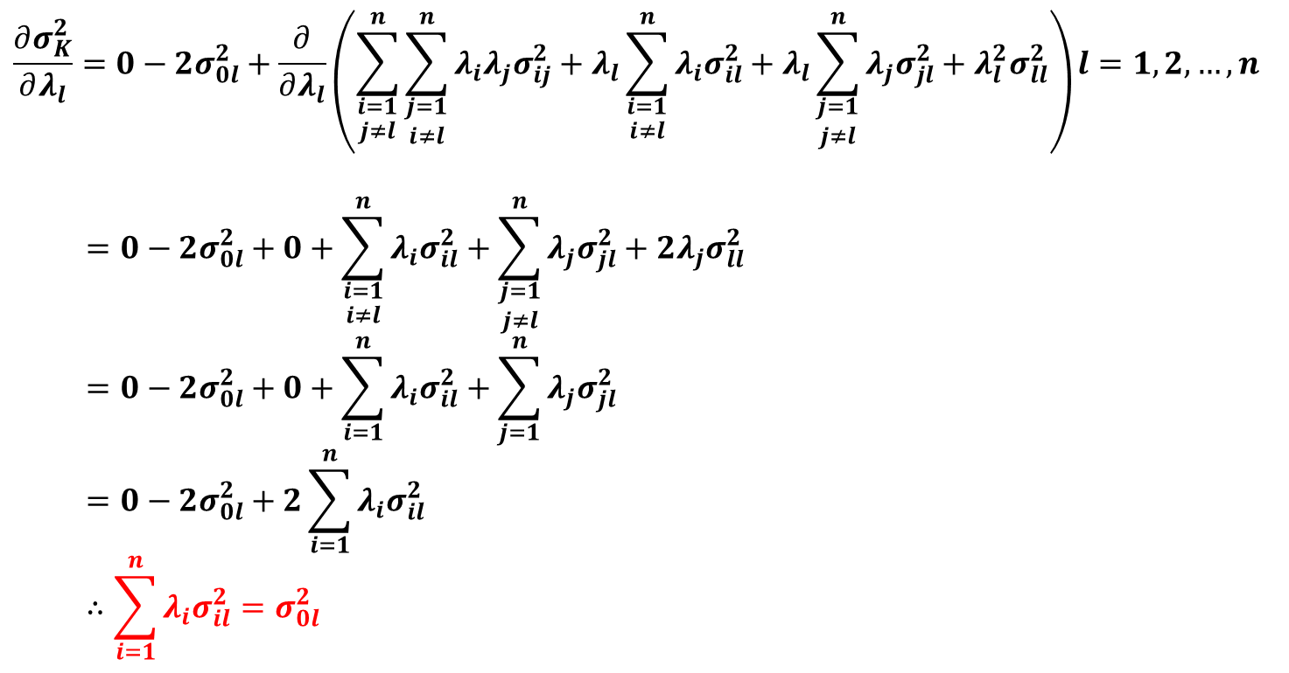
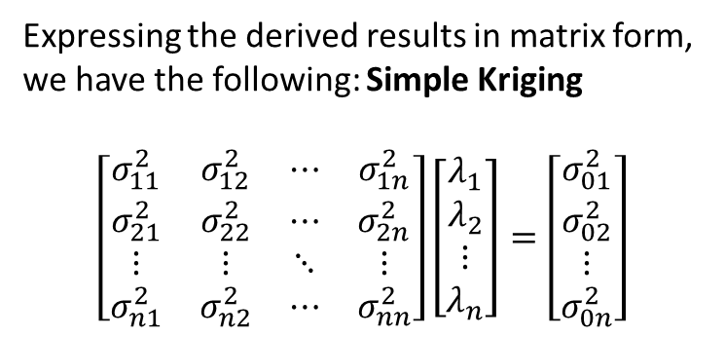
Kriging Theory
■ Spatial Estimation Concept
By differentiating the previously derived equation with respect to λ and simplifying, we obtain the following:
$$\frac{∂σ_{K}^{2}}{∂λ_{l}}=0−2σ_{0l}^{2}+\frac{∂}{∂λ_{l}}\left(\sum_{\begin{aligned}i=1 \\ j≠l\end{aligned}}^{n}{\sum_{\begin{aligned}j=1 \\ i≠l\end{aligned}}^{n}{λ_{i}λ_{j}σ_{ij}^{2}}}+λ_{l}\sum_{\begin{aligned}i=1 \\ i≠l\end{aligned}}^{n}{λ_{i}σ_{il}^{2}}+λ_{l}\sum_{\begin{aligned}j=1 \\ j≠l\end{aligned}}^{n}{λ_{j}σ_{jl}^{2}}+λ_{l}^{2}σ_{ll}^{2}\right)l=1,2,…,n$$
$$=0−2σ_{0l}^{2}+0+\sum_{\begin{aligned}i=1 \\ i≠l\end{aligned}}^{n}{λ_{i}σ_{il}^{2}}+\sum_{\begin{aligned}j=1 \\ j≠l\end{aligned}}^{n}{λ_{j}σ_{jl}^{2}}+2λ_{j}σ_{ll}^{2}$$
$$=0−2σ_{0l}^{2}+0+\sum_{i=1}^{n}{λ_{i}σ_{il}^{2}}+\sum_{j=1}^{n}{λ_{j}σ_{jl}^{2}}$$
$$=0−2σ_{0l}^{2}+2\sum_{i=1}^{n}{λ_{i}σ_{il}^{2}}$$
$$∴\sum_{i=1}^{n}{λ_{i}σ_{il}^{2}}=σ_{0l}^{2}$$
Expressing the derived results in matrix form, we have the following: Simple Kriging
$$\left[\begin{matrix}σ_{11}^{2} & σ_{12}^{2} & ⋯ & σ_{1n}^{2} \\ σ_{21}^{2} & σ_{22}^{2} & ⋯ & σ_{2n}^{2} \\ ⋮ & ⋮ & ⋱ & ⋮ \\ σ_{n1}^{2} & σ_{n2}^{2} & ⋯ & σ_{nn}^{2}\end{matrix}\right]\left[\begin{matrix}λ_{1} \\ λ_{2} \\ ⋮ \\ λ_{n}\end{matrix}\right]=\left[\begin{matrix}σ_{01}^{2} \\ σ_{02}^{2} \\ ⋮ \\ σ_{0n}^{2}\end{matrix}\right]$$

Slide 16
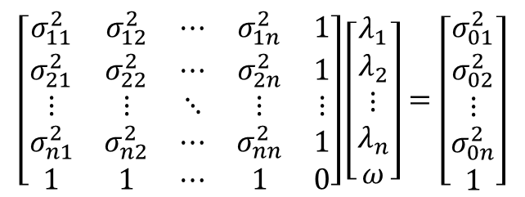
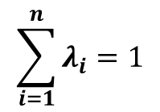
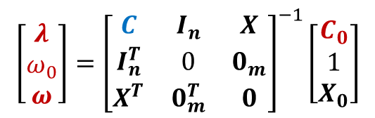
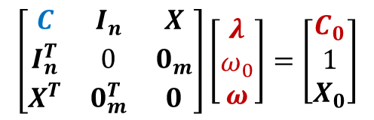
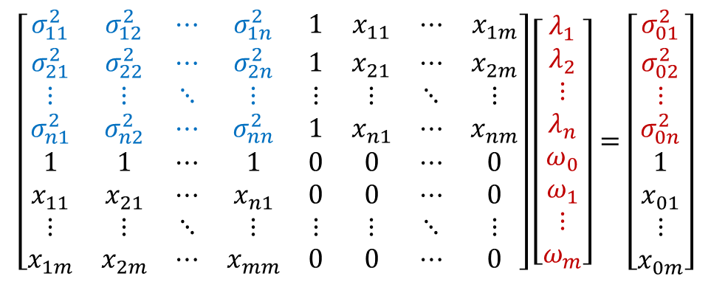
Kriging Theory
■ Extension of Kriging
Unbiased Estimation and Considering External Drifter
For Considering Spatial Trend, Add External Drifter
= Universal Kriging(Coordinates as Drifter)
For Unbiased Estimation, Using Lagrange Multiplier
= Ordinary Kriging
$$\left[\begin{matrix}σ_{11}^{2} & σ_{12}^{2} & ⋯ & σ_{1n}^{2} & 1 & x_{11} & ⋯ & x_{1m} \\ σ_{21}^{2} & σ_{22}^{2} & ⋯ & σ_{2n}^{2} & 1 & x_{21} & ⋯ & x_{2m} \\ ⋮ & ⋮ & ⋱ & ⋮ & ⋮ & ⋮ & ⋱ & ⋮ \\ σ_{n1}^{2} & σ_{n2}^{2} & ⋯ & σ_{nn}^{2} & 1 & x_{n1} & ⋯ & x_{nm} \\ 1 & 1 & ⋯ & 1 & 0 & 0 & ⋯ & 0 \\ x_{11} & x_{21} & ⋯ & x_{n1} & 0 & 0 & ⋯ & 0 \\ ⋮ & ⋮ & ⋱ & ⋮ & ⋮ & ⋮ & ⋱ & ⋮ \\ x_{1m} & x_{2m} & ⋯ & x_{mm} & 0 & 0 & ⋯ & 0\end{matrix}\right]\left[\begin{matrix}λ_{1} \\ λ_{2} \\ ⋮ \\ λ_{n} \\ ω_{0} \\ ω_{1} \\ ⋮ \\ ω_{m}\end{matrix}\right]=\left[\begin{matrix}σ_{01}^{2} \\ σ_{02}^{2} \\ ⋮ \\ σ_{0n}^{2} \\ 1 \\ x_{01} \\ ⋮ \\ x_{0m}\end{matrix}\right]$$
$$\sum_{i=1}^{n}{λ_{i}}=1$$
$$\left[\begin{matrix}σ_{11}^{2} & σ_{12}^{2} & ⋯ & σ_{1n}^{2} & 1 \\ σ_{21}^{2} & σ_{22}^{2} & ⋯ & σ_{2n}^{2} & 1 \\ ⋮ & ⋮ & ⋱ & ⋮ & ⋮ \\ σ_{n1}^{2} & σ_{n2}^{2} & ⋯ & σ_{nn}^{2} & 1 \\ 1 & 1 & ⋯ & 1 & 0\end{matrix}\right]\left[\begin{matrix}λ_{1} \\ λ_{2} \\ ⋮ \\ λ_{n} \\ ω\end{matrix}\right]=\left[\begin{matrix}σ_{01}^{2} \\ σ_{02}^{2} \\ ⋮ \\ σ_{0n}^{2} \\ 1\end{matrix}\right]$$
$$\left[\begin{matrix}C & I_{n} & X \\ I_{n}^{T} & 0 & 0_{m} \\ X^{T} & 0_{m}^{T} & 0\end{matrix}\right]\left[\begin{matrix}λ \\ ω_{0} \\ ω\end{matrix}\right]=\left[\begin{matrix}C_{0} \\ 1 \\ X_{0}\end{matrix}\right]$$
Known, Unknown, Unknown?
$$\left[\begin{matrix}λ \\ ω_{0} \\ ω\end{matrix}\right]={\left[\begin{matrix}C & I_{n} & X \\ I_{n}^{T} & 0 & 0_{m} \\ X^{T} & 0_{m}^{T} & 0\end{matrix}\right]}^{−1}\left[\begin{matrix}C_{0} \\ 1 \\ X_{0}\end{matrix}\right]$$
External Drifter

Slide 17
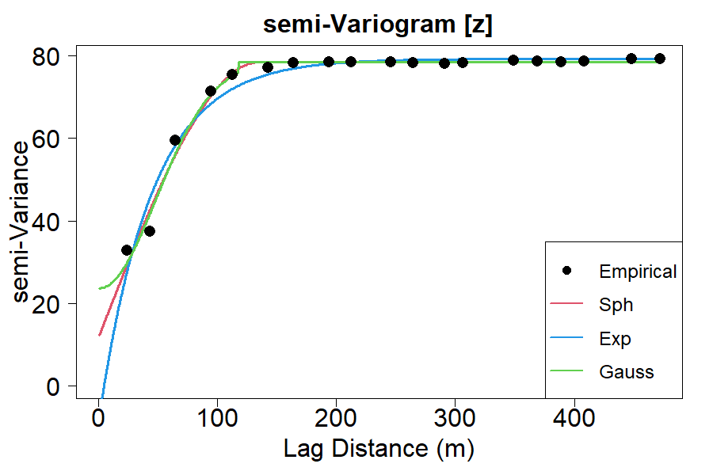

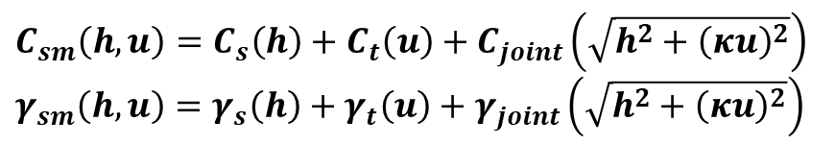
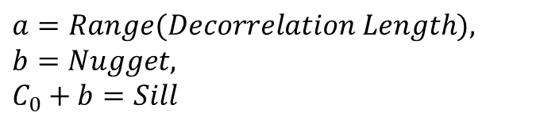
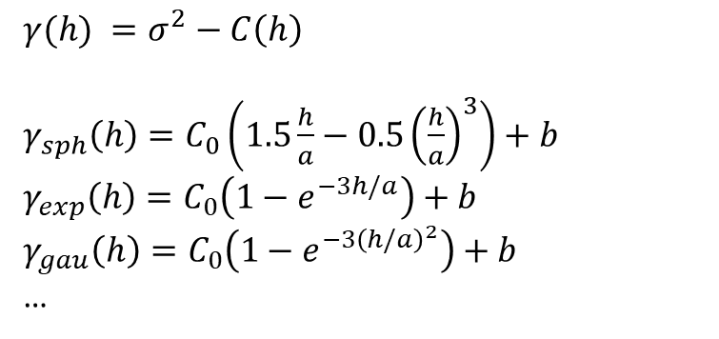
Variogram
■ Variogram Modeling
So, How do we calculate Unknown values?
$$\left[\begin{matrix}λ \\ ω_{0} \\ ω\end{matrix}\right]={\left[\begin{matrix}C & I_{n} & X \\ I_{n}^{T} & 0 & 0_{m} \\ X^{T} & 0_{m}^{T} & 0\end{matrix}\right]}^{−1}\left[\begin{matrix}C_{0} \\ 1 \\ X_{0}\end{matrix}\right]$$
Range
Known, Unknown, Unknown?
Sill
$γ(h) =σ^{2}−C\left(h\right)$
$γ_{sph}\left(h\right)=C_{0}\left(1.5\frac{h}{a}−0.5{\left(\frac{h}{a}\right)}^{3}\right)+b$
$γ_{exp}\left(h\right)=C_{0}\left(1−e^{−3h/a}\right)+b$
$γ_{gau}\left(h\right)=C_{0}\left(1−e^{−3{\left(h/a\right)}^{2}}\right)+b$
…
Nugget
$C_{sm}\left(h,u\right)=C_{s}\left(h\right)+C_{t}\left(u\right)+C_{joint}\left(\sqrt{h^{2}+{\left(κu\right)}^{2}}\right)$
$γ_{sm}\left(h,u\right)=γ_{s}\left(h\right)+γ_{t}\left(u\right)+γ_{joint}\left(\sqrt{h^{2}+{\left(κu\right)}^{2}}\right)$
$a=Range(Decorrelation Length),$
$b=Nugget,$
$C_{0}+b=Sill$
<Sum-Metric model(Gräler et al. ,2015)>
Gräler, B., Pebesma, Edzer, Heuvelink, G., 2015. Spatio-Temporal Interpolation using gstat.

Slide 18
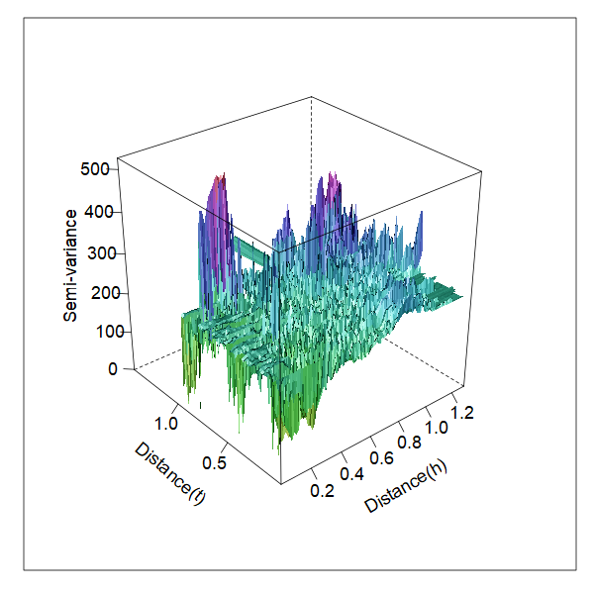
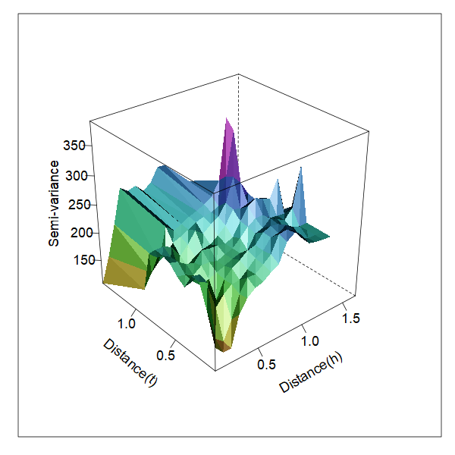
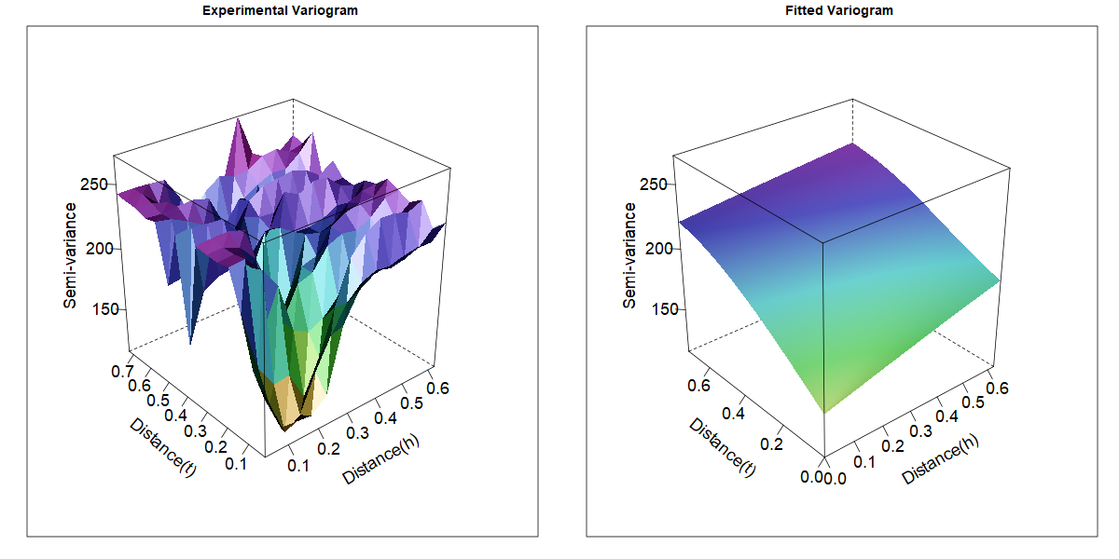
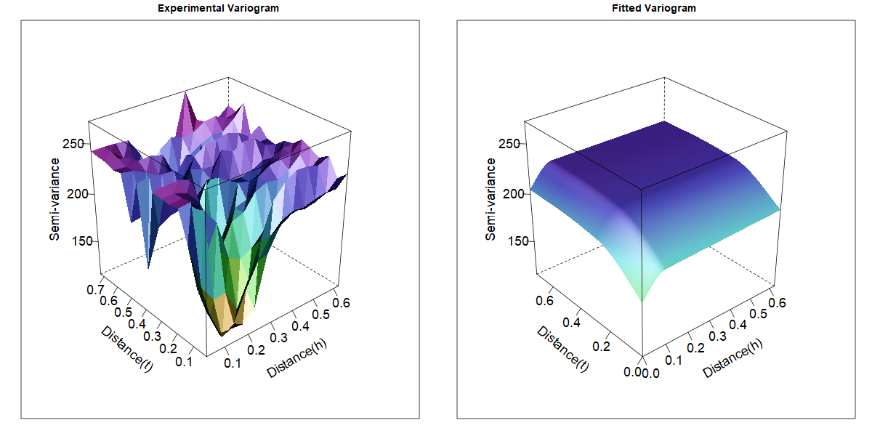
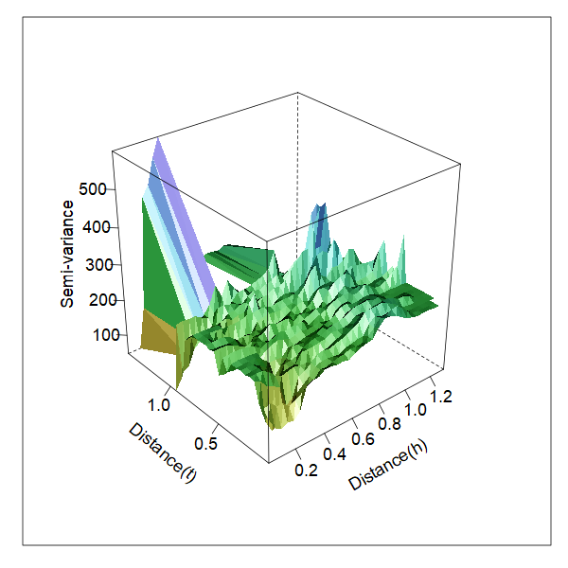
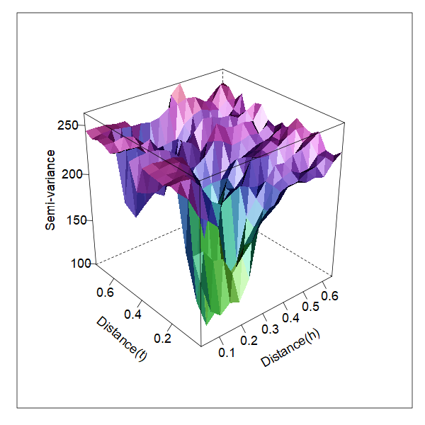
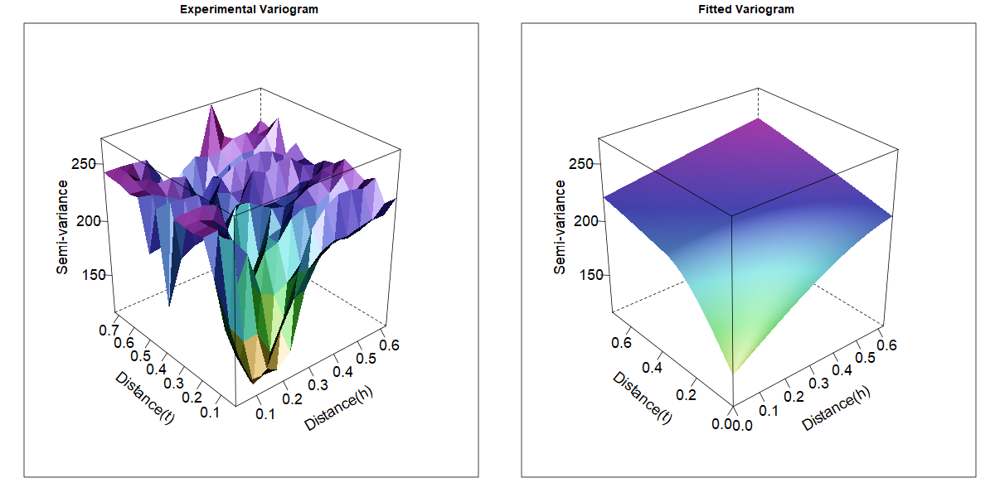
Variogram
The example uses 2019 nitrate data
■ Variogram Modeling
Empirical Variogram(EV)
Case 1
2 Gau
1 Sph
Case 2
Fit the Variogram
2 Sph
1 Exp
Case 3
3 Sph
Selected

Slide 19
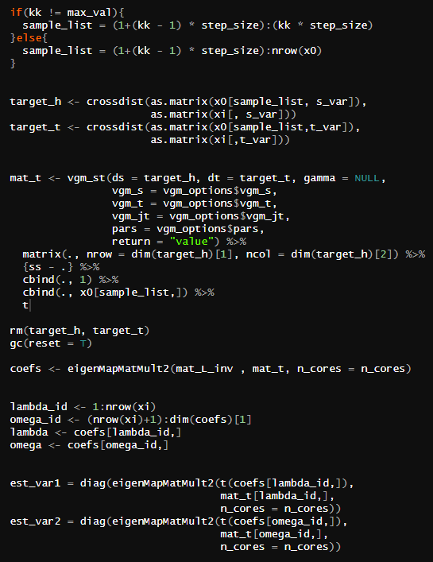
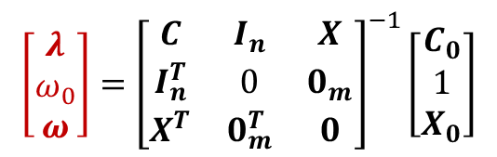
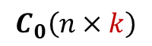
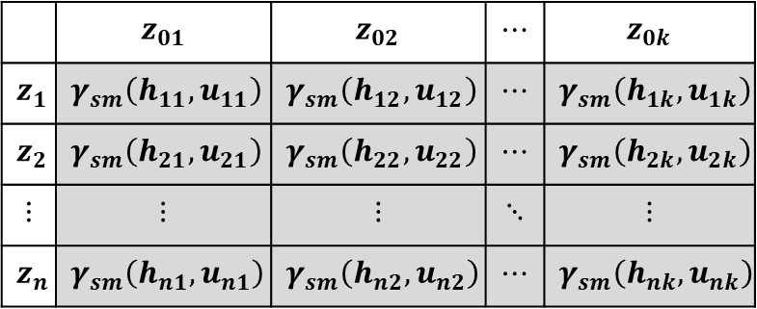
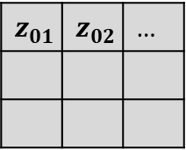
Just Calculate
■ Matrix Multiplication
Now all components are known except the weight vector
$$\left[\begin{matrix}λ \\ ω_{0} \\ ω\end{matrix}\right]={\left[\begin{matrix}C & I_{n} & X \\ I_{n}^{T} & 0 & 0_{m} \\ X^{T} & 0_{m}^{T} & 0\end{matrix}\right]}^{−1}\left[\begin{matrix}C_{0} \\ 1 \\ X_{0}\end{matrix}\right]$$
$$z_{01}$$ | $$z_{02}$$ | …
How many can your memory handle?
In my PC, kk <- 10000
Known, Unknown
However, this equation is for calculating the estimation of a single point!
So, Let's line them up all at once and solve them using a matrix
 | $$z_{01}$$ | $$z_{02}$$ | $$⋯$$ | $$z_{0k}$$
$$z_{1}$$ | $$γ_{sm}\left(h_{11},u_{11}\right)$$ | $$γ_{sm}\left(h_{12},u_{12}\right)$$ | $$⋯$$ | $$γ_{sm}\left(h_{1k},u_{1k}\right)$$
$$z_{2}$$ | $$γ_{sm}\left(h_{21},u_{21}\right)$$ | $$γ_{sm}\left(h_{22},u_{22}\right)$$ | $$⋯$$ | $$γ_{sm}\left(h_{2k},u_{2k}\right)$$
$$⋮$$ | $$⋮$$ | $$⋮$$ | $$⋱$$ | $$⋮$$
$$z_{n}$$ | $$γ_{sm}\left(h_{n1},u_{n1}\right)$$ | $$γ_{sm}\left(h_{n2},u_{n2}\right)$$ | $$⋯$$ | $$γ_{sm}\left(h_{nk},u_{nk}\right)$$
$$C_{0}\left(n×k\right)$$

Slide 20
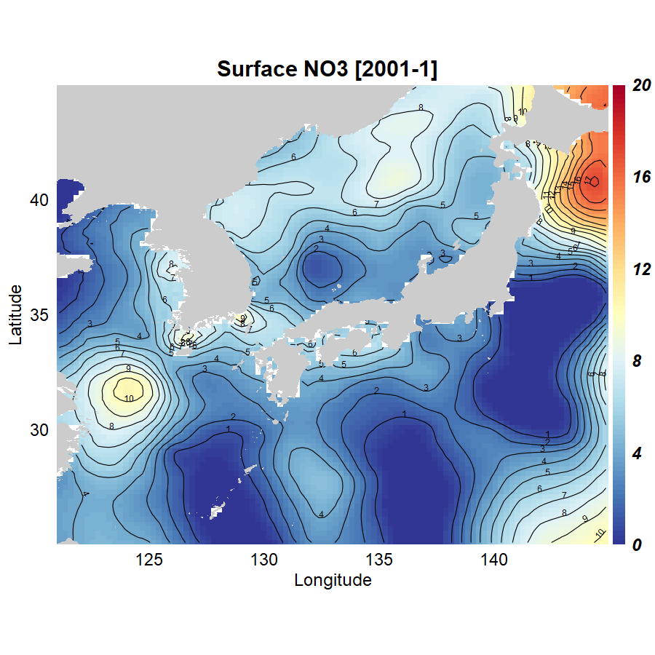
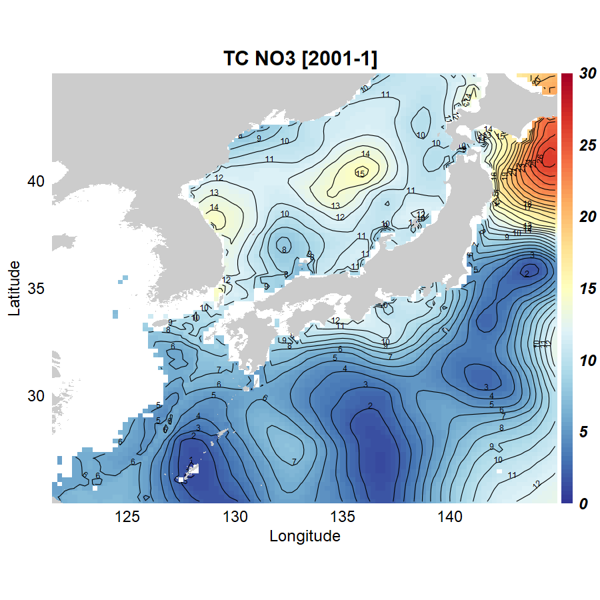
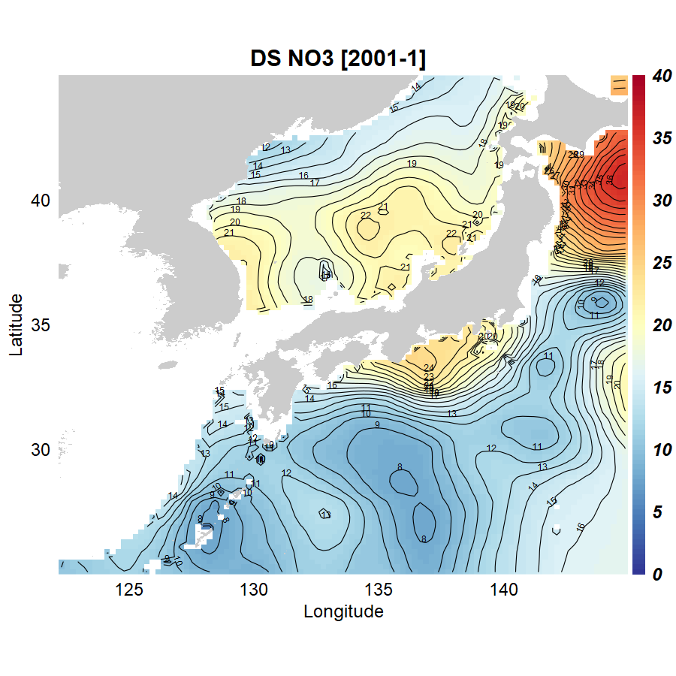
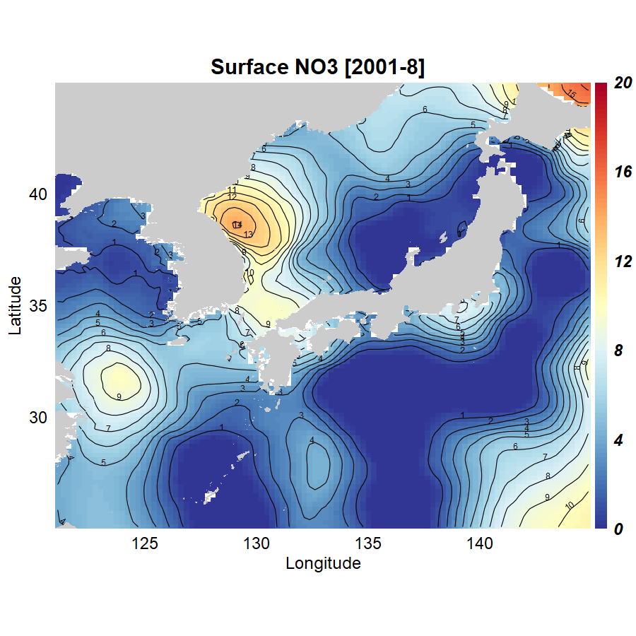
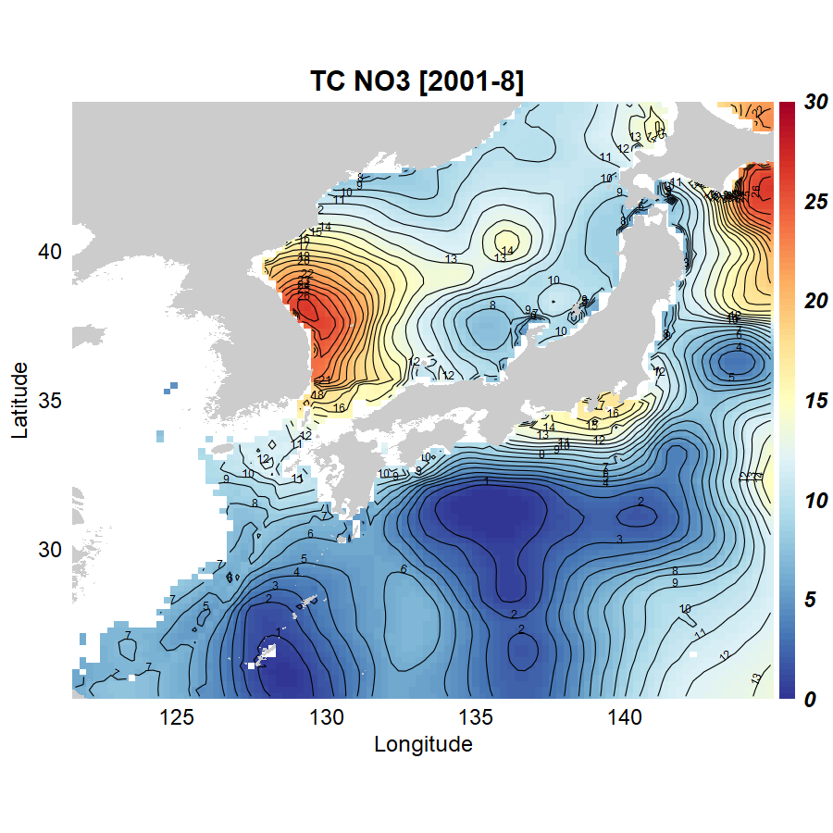
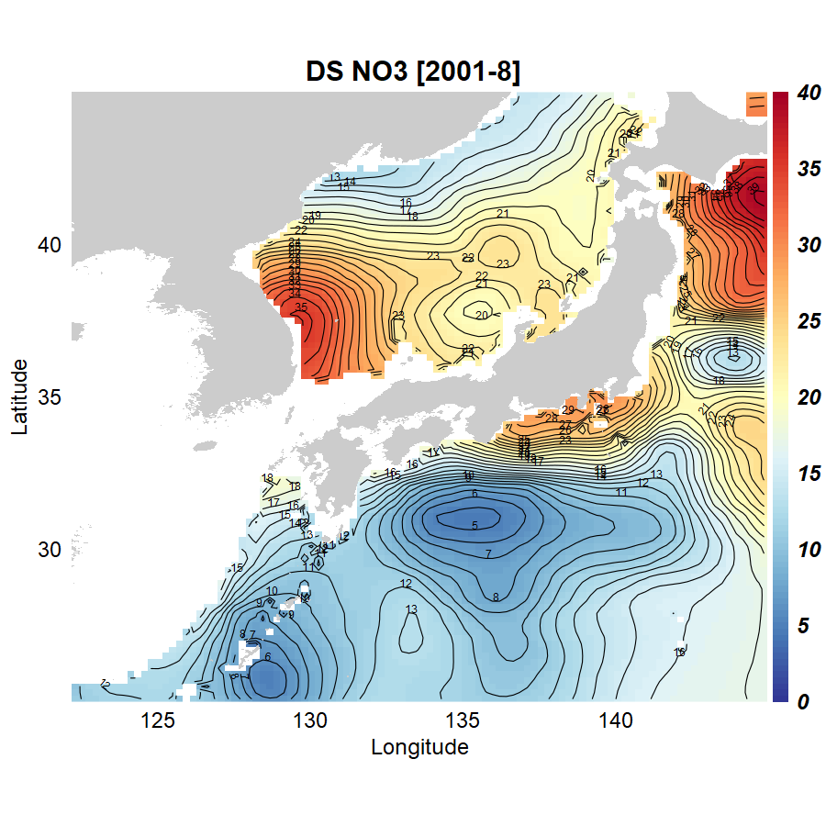
Estimation Results
■ Nitrate
0-50m
100-300m
300-500m
Jan 2001
0-50m
100-300m
300-500m
Aug 2001

Slide 21






Estimation Results
■ Phosphate
0-50m
100-300m
300-500m
Jan 2001
0-50m
100-300m
300-500m
Aug 2001

Slide 22



Validation
■ Cross Validation
Metric

Slide 23



Complexity in Kriging
■ With big O notation
Inverse $(n+p+1)×(n+p+1)$ matrix, complexity $≅O\left(n^{3}\right)$
Cholesky Decomposition can reduce the complexity to $O\left(n^{2}\right)$, but there are situations where the inverse cannot be calculated when using field observation data.
Microsoft R Open (MRO), which could parallelize the basic function ‘solve()’, was retired in 2022.
404 Page not found
<Generated by ChatGPT 4o>

Slide 24



Partially Accelerating R Code
■ With lower-level language and parallelization
It was necessary to execute various computational processes faster. We decided to use the well-known Rcpp for this purpose.
data.table To calculate the covariance based on combinations of data pairs, we performed group operations using the cut function's return value as the key with the `:=` function.
<Generated by ChatGPT 4o>
Using user-defined Rcpp functions instead of manipulating dist results
Using data.table for combination(CJ), key based column operation(`:=`)

Slide 25
Partially Accelerating R Code
■ With lower-level language and parallelization
Modifying Basic Linear Algebra Subprograms(BLAS) was too difficult, so at the very least, parallelizing simple matrix multiplications was necessary.
coefs <- as.numeric(mat_L_inv %*% mat_t)
lambda_id <- 1:nrow(sample_4d)
omega_id <- (nrow(sample_4d)+1):length(coefs)
lambda <- coefs[lambda_id]
omega <- coefs[omega_id]
est_val[kk] <- sum(sample_4d[,which(colnames(sample_4d) == "val")] %*% lambda)
est_var[kk] <- ss –
sum(coefs[lambda_id] %*% mat_t[lambda_id]) +
sum(coefs[omega_id] %*% mat_t[omega_id])
// [[Rcpp::depends(RcppArmadillo, RcppEigen)]]
// [[Rcpp::plugins(openmp)]]
#include <omp.h>
#include <RcppArmadillo.h>
#include <RcppEigen.h>
// [[Rcpp::export]]
SEXP eigenMapMatMult2(const Eigen::Map<Eigen::MatrixXd> A,
Eigen::Map<Eigen::MatrixXd> B,
int n_cores){
Eigen::setNbThreads(n_cores);
Eigen::MatrixXd C = A * B;
return Rcpp::wrap(C);
}
coefs <- eigenMapMatMult2(mat_L_inv , mat_t, n_cores = n_cores)
lambda_id <- 1:nrow(xi)
omega_id <- (nrow(xi)+1):dim(coefs)[1]
lambda <- coefs[lambda_id,]
omega <- coefs[omega_id,]
est_var1 = diag(eigenMapMatMult2(t(coefs[lambda_id,]),
mat_t[lambda_id,], n_cores = n_cores))
est_var2 = diag(eigenMapMatMult2(t(coefs[omega_id,]),
mat_t[omega_id,], n_cores = n_cores))

Slide 26

Sources on Github
■ Source on Github

Slide 27
Ⅳ
CHAPTER
Ongoing & Future Works

Slide 28

Other Dataset: Carbon
■ Global Carbon Dataset
SOCAT(Surface Ocean CO₂ Atlas)

Slide 29



Other Methods: Theoretical Perspective
■ Uncertainty Evaluation
Conditional Realization for Universal Kriging (Zhou et al., 2014)
$s_{ci}=Λ\left(z−z_{ui}\right)+s_{ui}$
$\left[\begin{matrix}z_{ui} \\ s_{ui}\end{matrix}\right]=C^{T}u$ , $\left[\begin{matrix}Q_{zz} & Q_{zs} \\ Q_{zs}^{T} & Q_{ss}\end{matrix}\right]=CC^{T}$; Where $u$ is $\sim N(0,σ^{2}+σ_{Q}^{2})$,
$Q_{ss}$ is the Spatial covariance,
$C^{T}$ is the matrix obtained from the Cholesky decomposition of the covariance matrix mentioned above
■ Co-Kriging or KED with more External variables
$$\left[\begin{matrix}C_{z}\left(x_{1},x_{1}\right) & ⋯ & C_{z}\left(x_{1},x_{n}\right) & C_{zu}\left(x_{1},x_{1}^{′}\right) & ⋯ & C_{zu}\left(x_{1},x_{m}^{′}\right) & −1 \\ ⋮ & ⋱ & ⋮ & ⋮ & ⋱ & ⋮ & ⋮ \\ C_{z}\left(x_{n},x_{1}\right) & ⋯ & C_{z}\left(x_{n},x_{n}\right) & C_{zu}\left(x_{n},x_{1}^{′}\right) & ⋯ & C_{zu}\left(x_{n},x_{m}^{′}\right) & −1 \\ C_{zu}\left(x_{1},x_{1}^{′}\right) & ⋯ & C_{zu}\left(x_{n},x_{1}^{′}\right) & C_{u}\left(x_{1}^{′},x_{1}^{′}\right) & ⋯ & C_{u}\left(x_{1}^{′},x_{m}^{′}\right) & −1 \\ ⋮ & ⋱ & ⋮ & ⋮ & ⋱ & ⋮ & ⋮ \\ C_{zu}\left(x_{1},x_{m}^{′}\right) & ⋯ & C_{zu}\left(x_{n},x_{m}^{′}\right) & C_{u}\left(x_{m}^{′},x_{1}^{′}\right) & ⋯ & C_{u}\left(x_{m}^{′},x_{m}^{′}\right) & −1 \\ 1 & ⋯ & 1 & 1 & ⋯ & 1 & 0\end{matrix}\right]\left[\begin{matrix}λ_{1} \\ ⋮ \\ λ_{n} \\ κ_{1} \\ ⋮ \\ κ_{m} \\ ω_{1}\end{matrix}\right]=\left[\begin{matrix}C_{z}\left(x_{0},x_{1}\right) \\ ⋮ \\ C_{z}\left(x_{0},x_{n}\right) \\ C_{zu}\left(x_{0},x_{1}^{′}\right) \\ ⋮ \\ C_{zu}\left(x_{0},x_{m}^{′}\right) \\ 1\end{matrix}\right]$$
$$\left[\begin{matrix}C_{z} & C_{zu} & I_{n} \\ C_{zu}^{T} & C_{u} & I_{m} \\ I_{n}^{T} & I_{m}^{T} & 0\end{matrix}\right]\left[\begin{matrix}λ \\ κ \\ ω_{1}\end{matrix}\right]\left[\begin{matrix}C_{z}^{0} \\ C_{zu}^{0} \\ 1\end{matrix}\right]$$

Slide 30
Other Methods: Technical Perspective
■ More Efficient Ways for Kriging
Reduction matrix size (using FNN, based on Approximate Nearest Neighbor)
Improving Computational Complexity (or Parallelizing)
Considering the torch library as a basic computational tool
Torch tensor-based operations are faster in tests
Var1 | Var2 | dist
X1 | X2 | 1
X1 | X3 | 10
X1 | X4 | 3
X1 | X5 | 2
X1 | X6 | 7
… | … | …
Truncated
h < range(5)
When Range parameter is 5,
truncated data pairs ██
■ Would AI help?
(in earth science,) “The key limitation of AI models is the lack of interpretability in the structures and the outputs”(Xu et al., 2021)
Use domain knowledge as a constraints in AI model
With Bayesian modeling, AI models improve the interpretability
It's an ongoing area of research
Xu, L., Chen, N., Chen, Z., Zhang, C., & Yu, H. (2021). Spatiotemporal forecasting in earth system science: Methods, uncertainties, predictability and future directions. Earth-Science Reviews, 222, 103828.

Slide 31

Thank You

